Slide 1
DIYALA UNIVERSITY COLLEGE OF ENGINEERING DEPARTMENT OF COMMUNICATION ENGINEERING
Electronic I
By
Asst. lecturer
WISAM HAYDER MAHDI
Lecture 3
December 2020

Slide 2
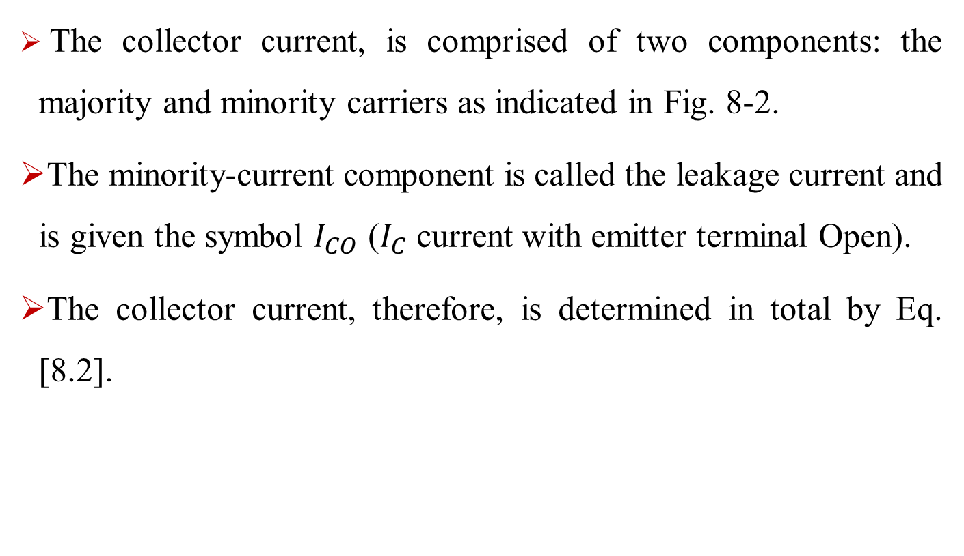
Active Region Operation
The collector current, is comprised of two components: the majority and minority carriers as indicated in Fig. 8-2.
The minority-current component is called the leakage current and is given the symbol $I_{CO}$ ($I_{C}$ current with emitter terminal Open).
The collector current, therefore, is determined in total by Eq. [8.2].
Notes:
aaa

Slide 3
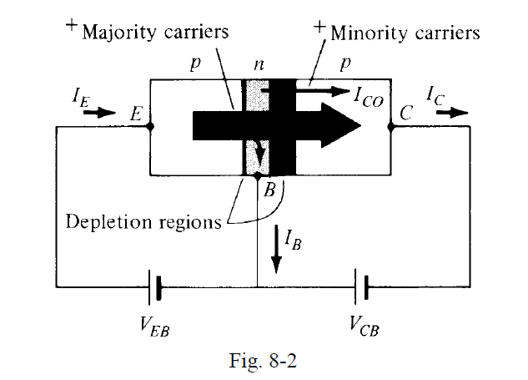
Active Region Operation
Notes:
aaa

Slide 4
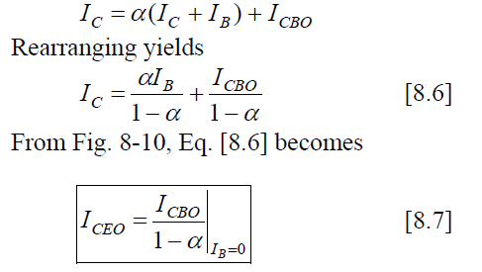
Common-Emitter (CE) Configuration
Example: Determine the dc current gain ${ \text{β}}_{\text{DC}}$ and the emitter current $I_{E}$ for a transistor where $I_{B}$ = 50μ𝐴 and $I_{C}$ = 3.65 𝑚𝐴.
${ \text{β}}_{\text{DC}} =\frac{I_{C}}{I_{B}}=\frac{3.65mA}{50\text{μ}\text{A}}$ = 73
$I_{E}$ = $I_{B}+ I_{C}$ , $I_{E}$ = 3.65 𝑚𝐴 + 50μ𝐴 = 3.7 𝑚
From common base :
From Eqs. [8.1] and [8.4], we obtain
Notes:
aaa

Slide 5
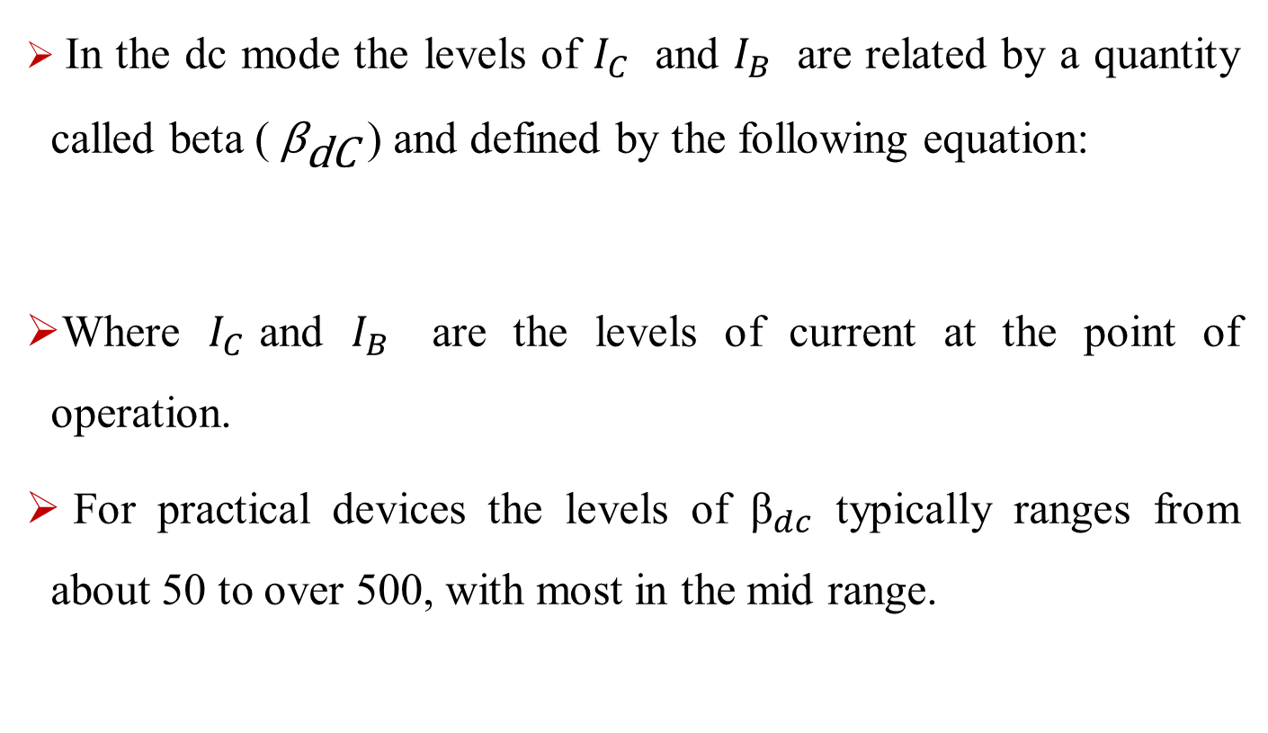
Common-Emitter (CE) Configuration
In the dc mode the levels of $I_{C}$ and $I_{B}$ are related by a quantity called beta (${ \text{β}}_{\text{d}\text{C}}$) and defined by the following equation:
Where $I_{C}$and $I_{B}$ are the levels of current at the point of operation.
For practical devices the levels of ${\text{β}}_{dc}$ typically ranges from about 50 to over 500, with most in the mid range.
Notes:
aaa

Slide 6
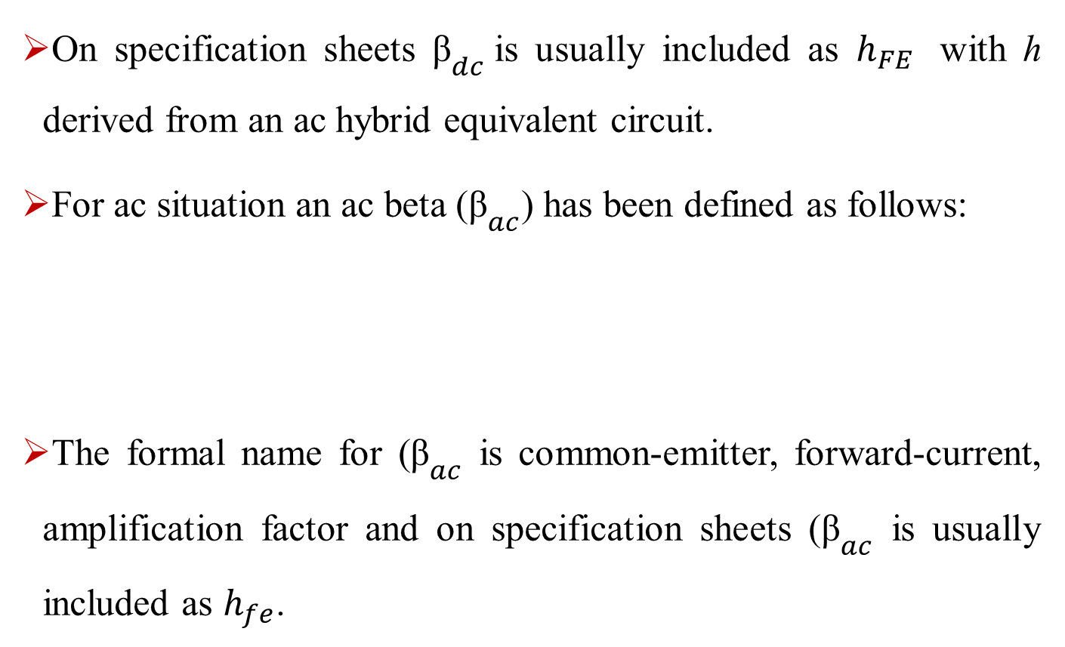
Common-Emitter (CE) Configuration
On specification sheets ${\text{β}}_{dc}$is usually included as $h_{FE}$ with h derived from an ac hybrid equivalent circuit.
For ac situation an ac beta (${\text{β}}_{ac}$) has been defined as follows:
The formal name for (${\text{β}}_{ac}$ is common-emitter, forward-current, amplification factor and on specification sheets (${\text{β}}_{ac}$ is usually included as $h_{fe}$.
Notes:
aaa

Slide 7
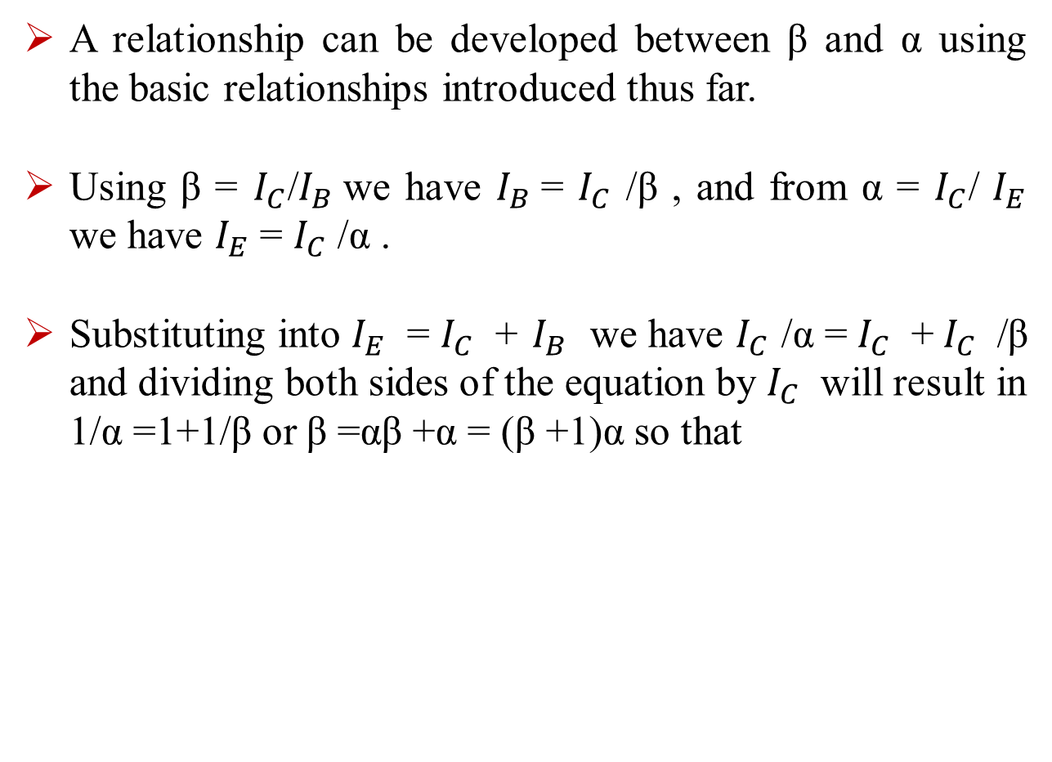
Common-Emitter (CE) Configuration
A relationship can be developed between β and α using the basic relationships introduced thus far.
Using β = $I_{C}$/$I_{B}$we have $I_{B}$= $I_{C}$ /β , and from α = $I_{C}$/ $I_{E}$ we have $I_{E}$ = $I_{C}$ /α .
Substituting into $I_{E}$ = $I_{C}$ + $I_{B}$ we have $I_{C}$ /α = $I_{C}$ + $I_{C}$ /β and dividing both sides of the equation by $I_{C}$ will result in 1/α =1+1/β or β =αβ +α = (β +1)α so that
Notes:
aaa

Slide 8
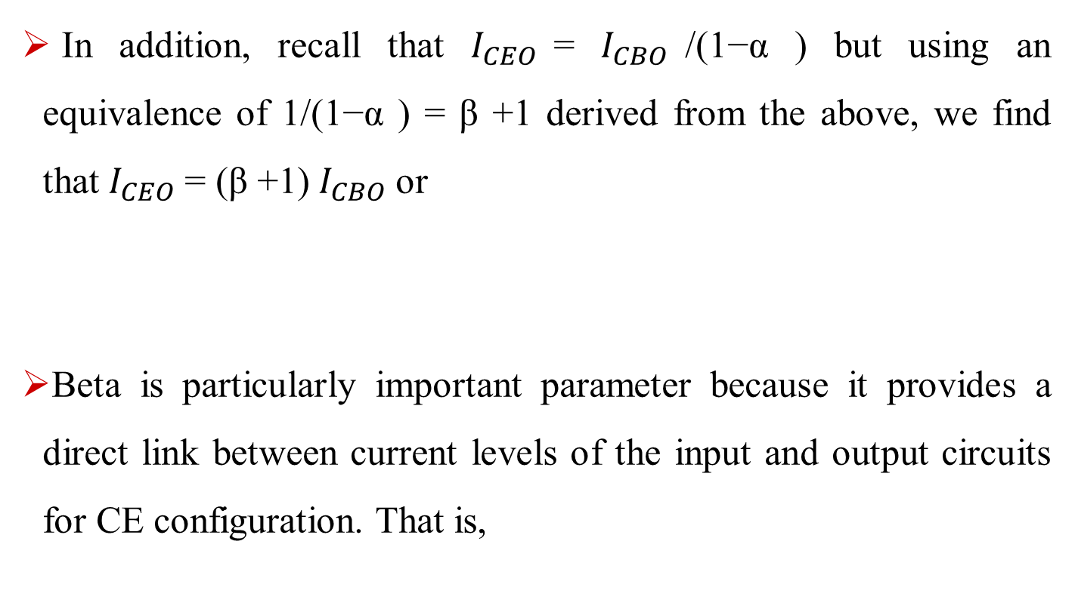
Common-Emitter (CE) Configuration
In addition, recall that $I_{CEO}$= $I_{CBO}$/(1−α ) but using an equivalence of 1/(1−α ) = β +1 derived from the above, we find that $I_{CEO}$= (β +1) $I_{CBO}$or
Beta is particularly important parameter because it provides a direct link between current levels of the input and output circuits for CE configuration. That is,
Notes:
aaa

Slide 9

Common-Emitter (CE) Configuration
and since $I_{E}$ = $I_{C}$ + $I_{B}$ = ${\text{β}}_{IB}$ + $I_{B}$ we have
Notes:
aaa

Slide 10
Common-Collector (CC) Configuration:
The third and final transistor configuration is the common-collector configuration, shown in Fig. 1 with npn and pnp transistors.
The CC configuration is used primarily for impedance-matching purposes since it has a high input impedance and low output impedance, opposite to that which is true of the common-base and common-emitter configurations.
Notes:
aaa

Slide 11
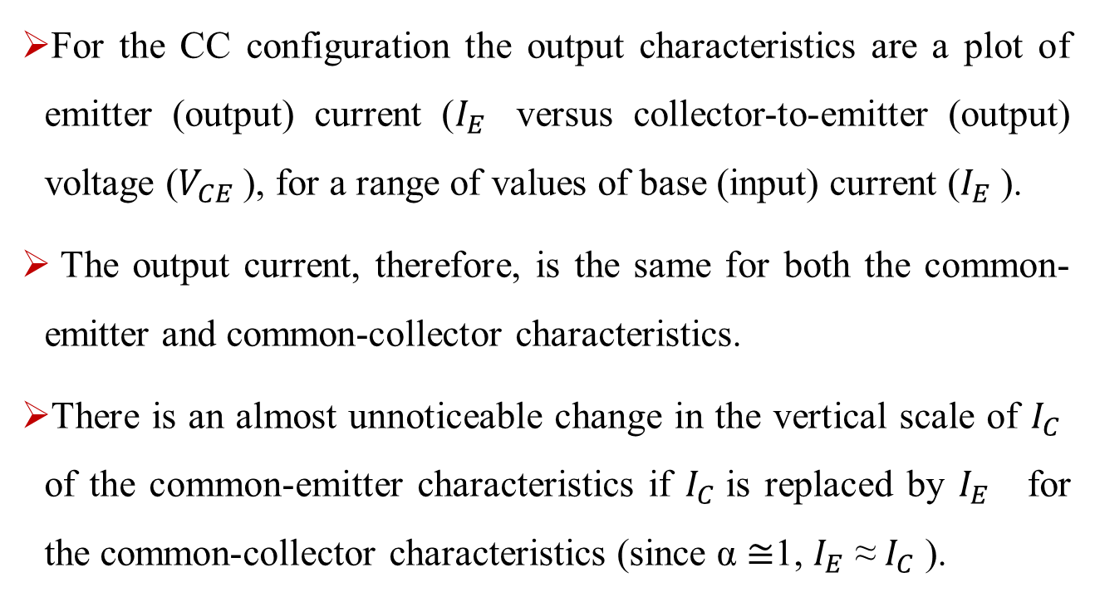
Common-Collector (CC) Configuration:
For the CC configuration the output characteristics are a plot of emitter (output) current ($I_{E}$ versus collector-to-emitter (output) voltage ($V_{CE}$), for a range of values of base (input) current ($I_{E}$).
The output current, therefore, is the same for both the common-emitter and common-collector characteristics.
There is an almost unnoticeable change in the vertical scale of $I_{C}$ of the common-emitter characteristics if $I_{C}$is replaced by $I_{E}$ for the common-collector characteristics (since α ≅1, $I_{E}$ ≈ $I_{C}$ ).

Slide 12
Common-Collector (CC) Configuration:
Fig. 1

Slide 13
DC Biasing Circuits of BJTs
Basic Concepts:
The term biasing appearing is an all-inclusive term for the application of dc voltages to establish a fixed level of current and voltage.
For transistor amplifiers the resulting dc current and voltage establish an operating point on the characteristics that define the region that will be employed for amplification of the applied signal.
Since the operating point is a fixed point on the characteristics, it is also called the quiescent point (abbreviated Q-point).

Slide 14
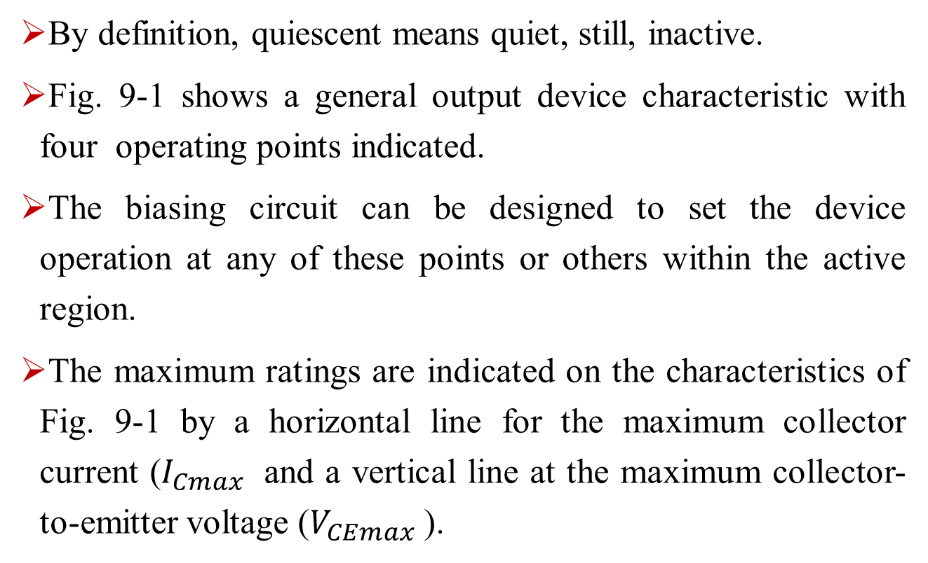
DC Biasing Circuits of BJTs
By definition, quiescent means quiet, still, inactive.
Fig. 9-1 shows a general output device characteristic with four operating points indicated.
The biasing circuit can be designed to set the device operation at any of these points or others within the active region.
The maximum ratings are indicated on the characteristics of Fig. 9-1 by a horizontal line for the maximum collector current ($I_{Cmax}$ and a vertical line at the maximum collector-to-emitter voltage ($V_{CEmax}$).

Slide 15
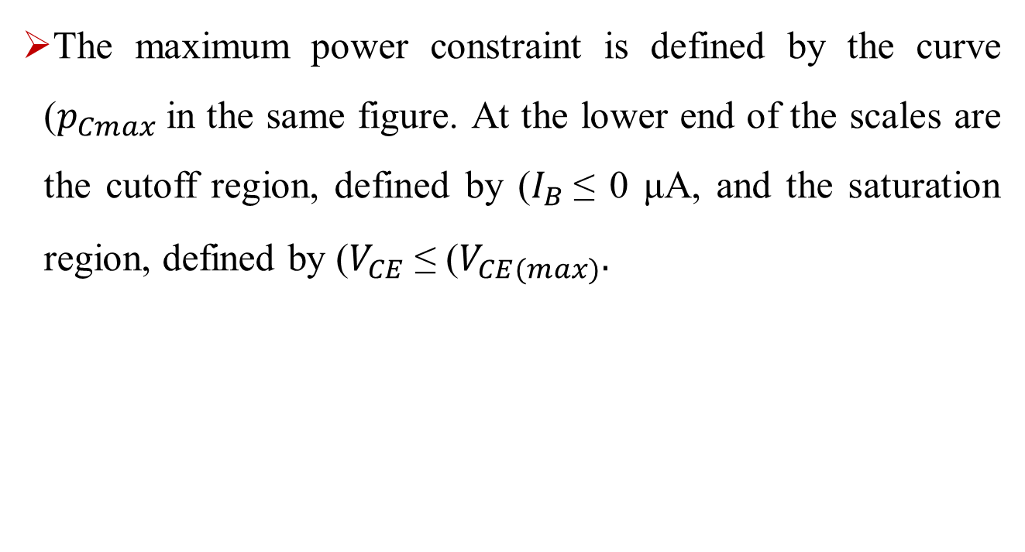
DC Biasing Circuits of BJTs
The maximum power constraint is defined by the curve ($p_{Cmax}$in the same figure. At the lower end of the scales are the cutoff region, defined by ($I_{B}$≤ 0 μA, and the saturation region, defined by ($V_{CE}$≤ ($V_{CE(max)}.$

Slide 16
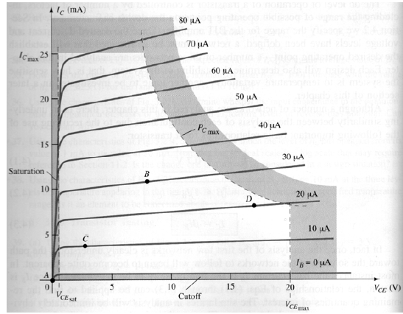
DC Biasing Circuits of BJTs
Fig. 9-1

